Slide 1

Flutter Fundamentals: Mastering Widgets and State
Unlocking the power of Flutter development through a deep dive into widgets and managing dynamic state.

Slide 2

Week 3 Objectives
Understand the Widget Tree
Grasp the hierarchical structure of Flutter UI components.
Stateless vs. Stateful Widgets
Differentiate between static and dynamic UI elements.
Widget Class Structure
Learn the basic blueprint for creating your own widgets.
Implement Basic Interaction
Bring your UI to life with simple state-driven interactions.

Slide 3


RECAP
Everything is a Widget
"Everything in Flutter is a Widget."
Widgets describe their view based on configuration and state.
UI Controls
Layouts
Styling
Buttons
Rows & Columns
Themes
Text Fields
Padding
Colors
Icons
Containers
Fonts

Slide 4
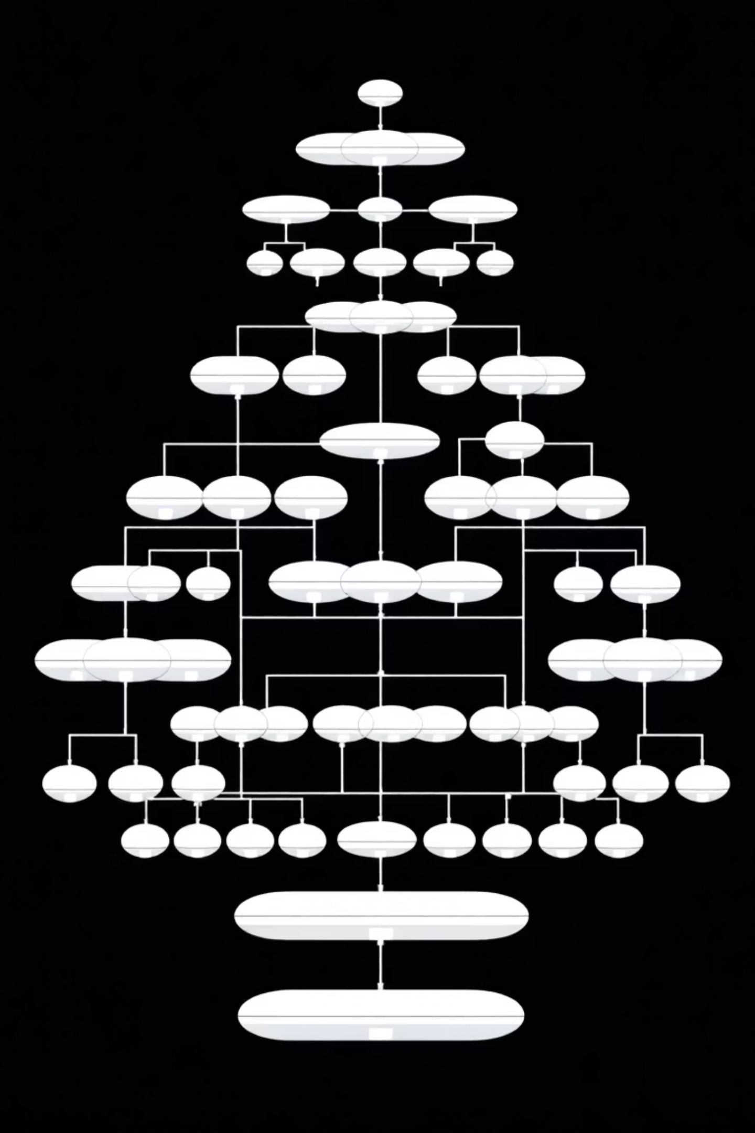
The Widget Tree Structure
01
Hierarchical UI
Flutter builds UIs by composing widgets into a nested tree structure.
02
Parent Widget
A container holding other widgets as its children.
03
Child Widget
A widget nested within another parent widget.
04
Root Widget
The top-level widget, typically starting at main().

Slide 5
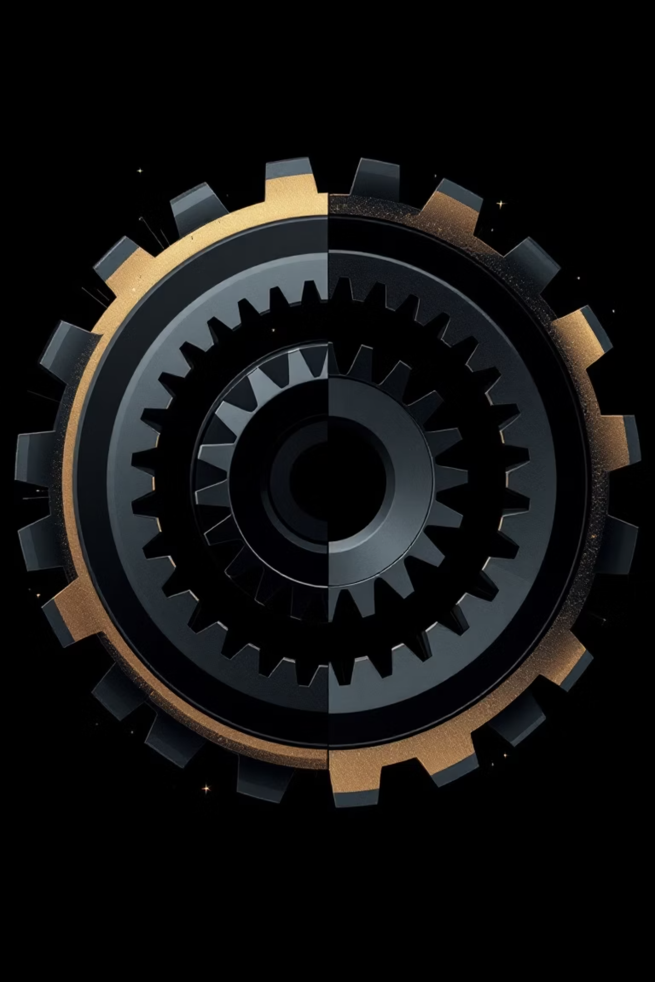
Two Main Types of Widgets
Stateless Widgets
Static, unchangeable once built.
Stateful Widgets
Dynamic, can change during runtime.
Understanding these categories is crucial for effective UI development in Flutter.

Slide 6

What is a Stateless Widget?
1
2
No Mutable State
Immutable
Does not require internal state changes.
Properties are final; cannot change after creation.
3
Single Build
build method is called only once.
Use Cases:
Icons
Text Labels
Static Images
Fixed UI elements

Slide 7
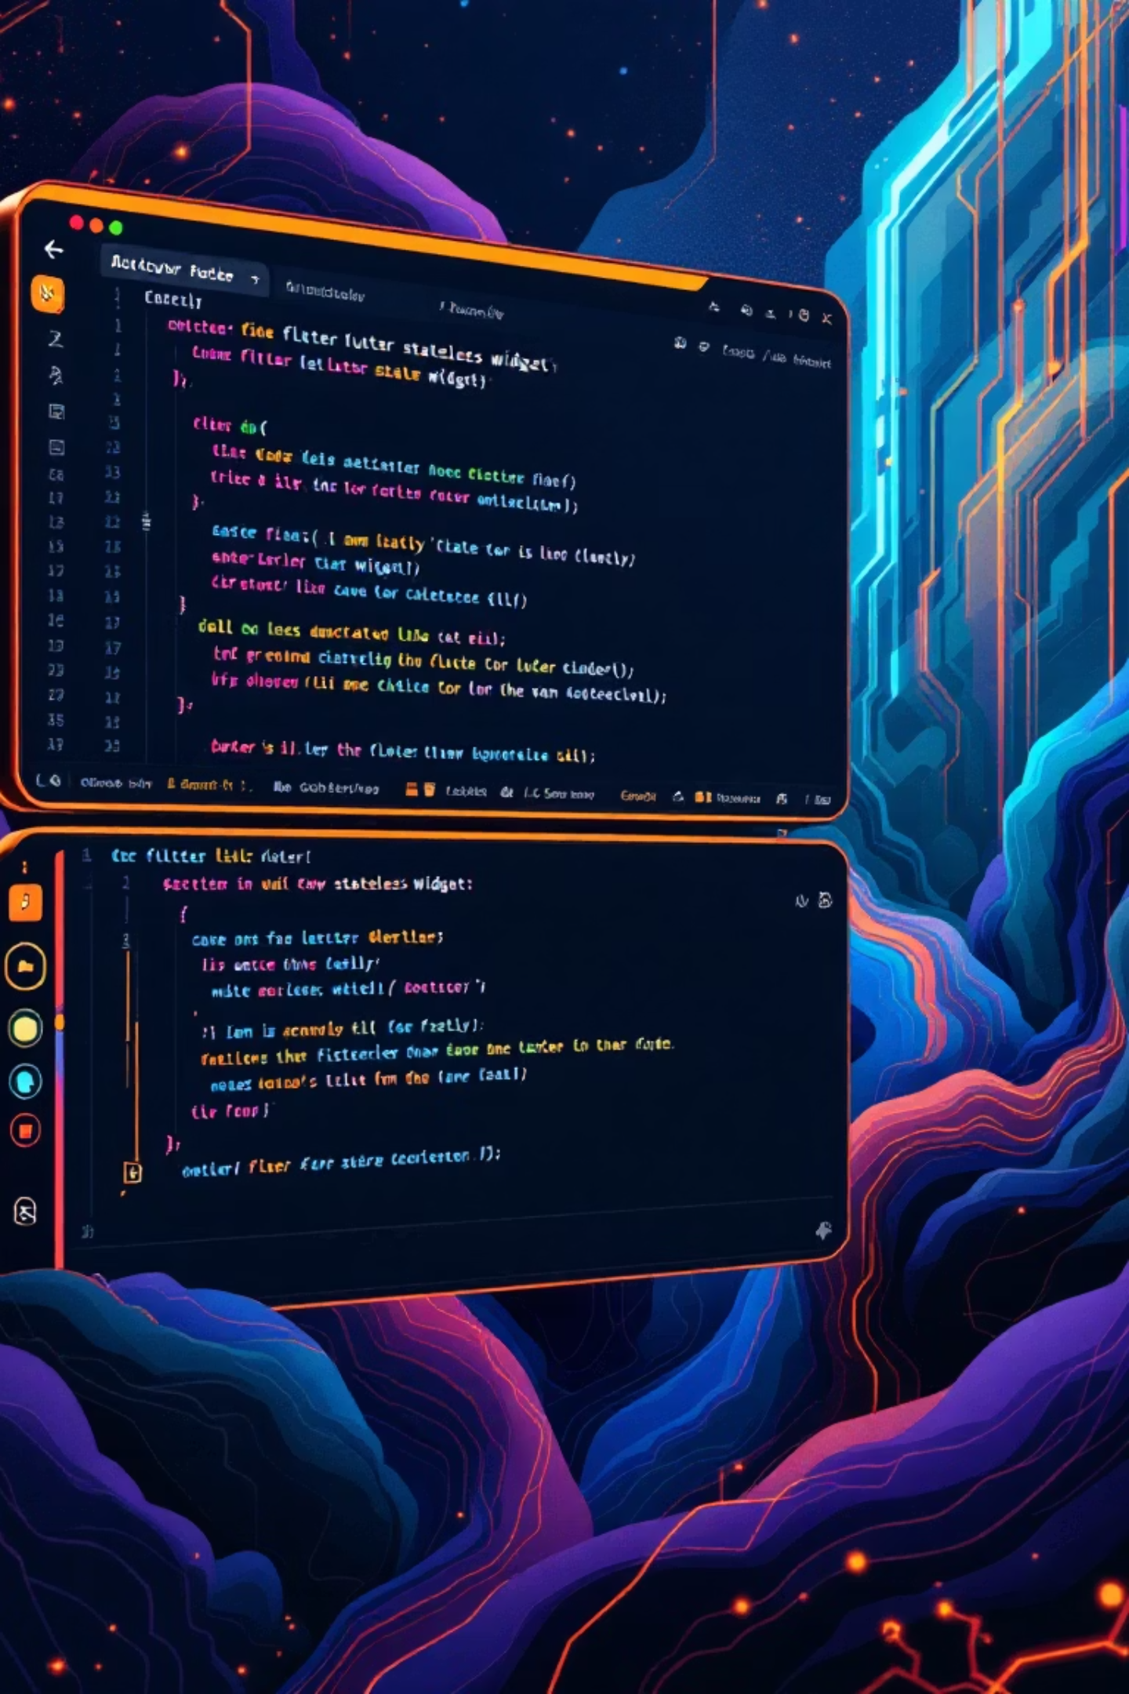

Stateless Widget Example
import 'package:flutter/material.dart'; class MyStatelessWidget extends StatelessWidget { @override Widget build(BuildContext context) { return Container( color: Colors.blue, child: Text('I am Stateless'), ); } }
This simple widget demonstrates an unchangeable UI element.

Slide 8

What is a Stateful Widget?
Mutable State
Possesses internal state that can change.
Dynamic Changes
Can update during the widget's lifecycle.
State Object
Maintains a separate State object for mutable data.
Rebuilds on Update
Triggers UI rebuild when setState() is called.
Use Cases:
Checkboxes
Form Inputs
Sliders & Counters
Interactive elements

Slide 9


Stateful Widget Example
class MyStatefulWidget extends StatefulWidget { @override _MyStatefulWidgetState createState() => _MyStatefulWidgetState(); } class _MyStatefulWidgetState extends State<MyStatefulWidget> { int count = 0; @override Widget build(BuildContext context) { return ElevatedButton( onPressed: () { // setState triggers the UI update setState(() { count++; }); }, child: Text("Count: $count") ); } }
This counter example illustrates dynamic UI updates with setState().

Slide 10
Stateless vs. Stateful: Key Differences
State
Immutable
Mutable
Changes
Cannot change after build
Can change via setState()
Rebuilds
Only when parent changes
When setState() is called
Understanding setState()
Critical Method: Notifies Flutter framework of internal state changes.
Triggers Rebuild: Forces the build() method to run again, updating the UI.
Changing variables without setState() will NOT update the UI!

